Slide 1
C12.b
Bioinformatics Resources at TSRI
And approaches to RNA-Seq

Slide 2
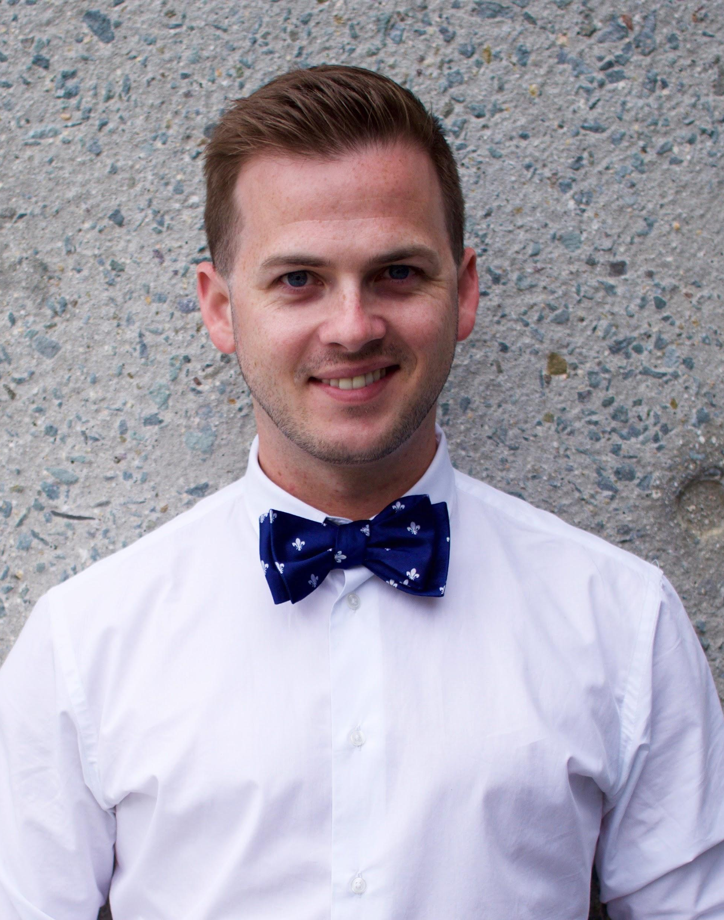
Charles Daniel Murin, Ph.D.
Senior Postdoctoral Associate
Ward Lab Scripps CA
cmurin@scripps.edu
Notes:
Want to know if you encounter unwelcoming behavior outside or inside classroom

Slide 3



B.S. in Chemistry/Biochemistry from The University of Southern Mississippi
Ph.D. in Biophysics from The Scripps Research Institute (cryo-EM)
Currently a 5th year postdoc in the lab of Dr. Andrew Ward
Course Director/Lecturer for Technologies Across Scale

Slide 4
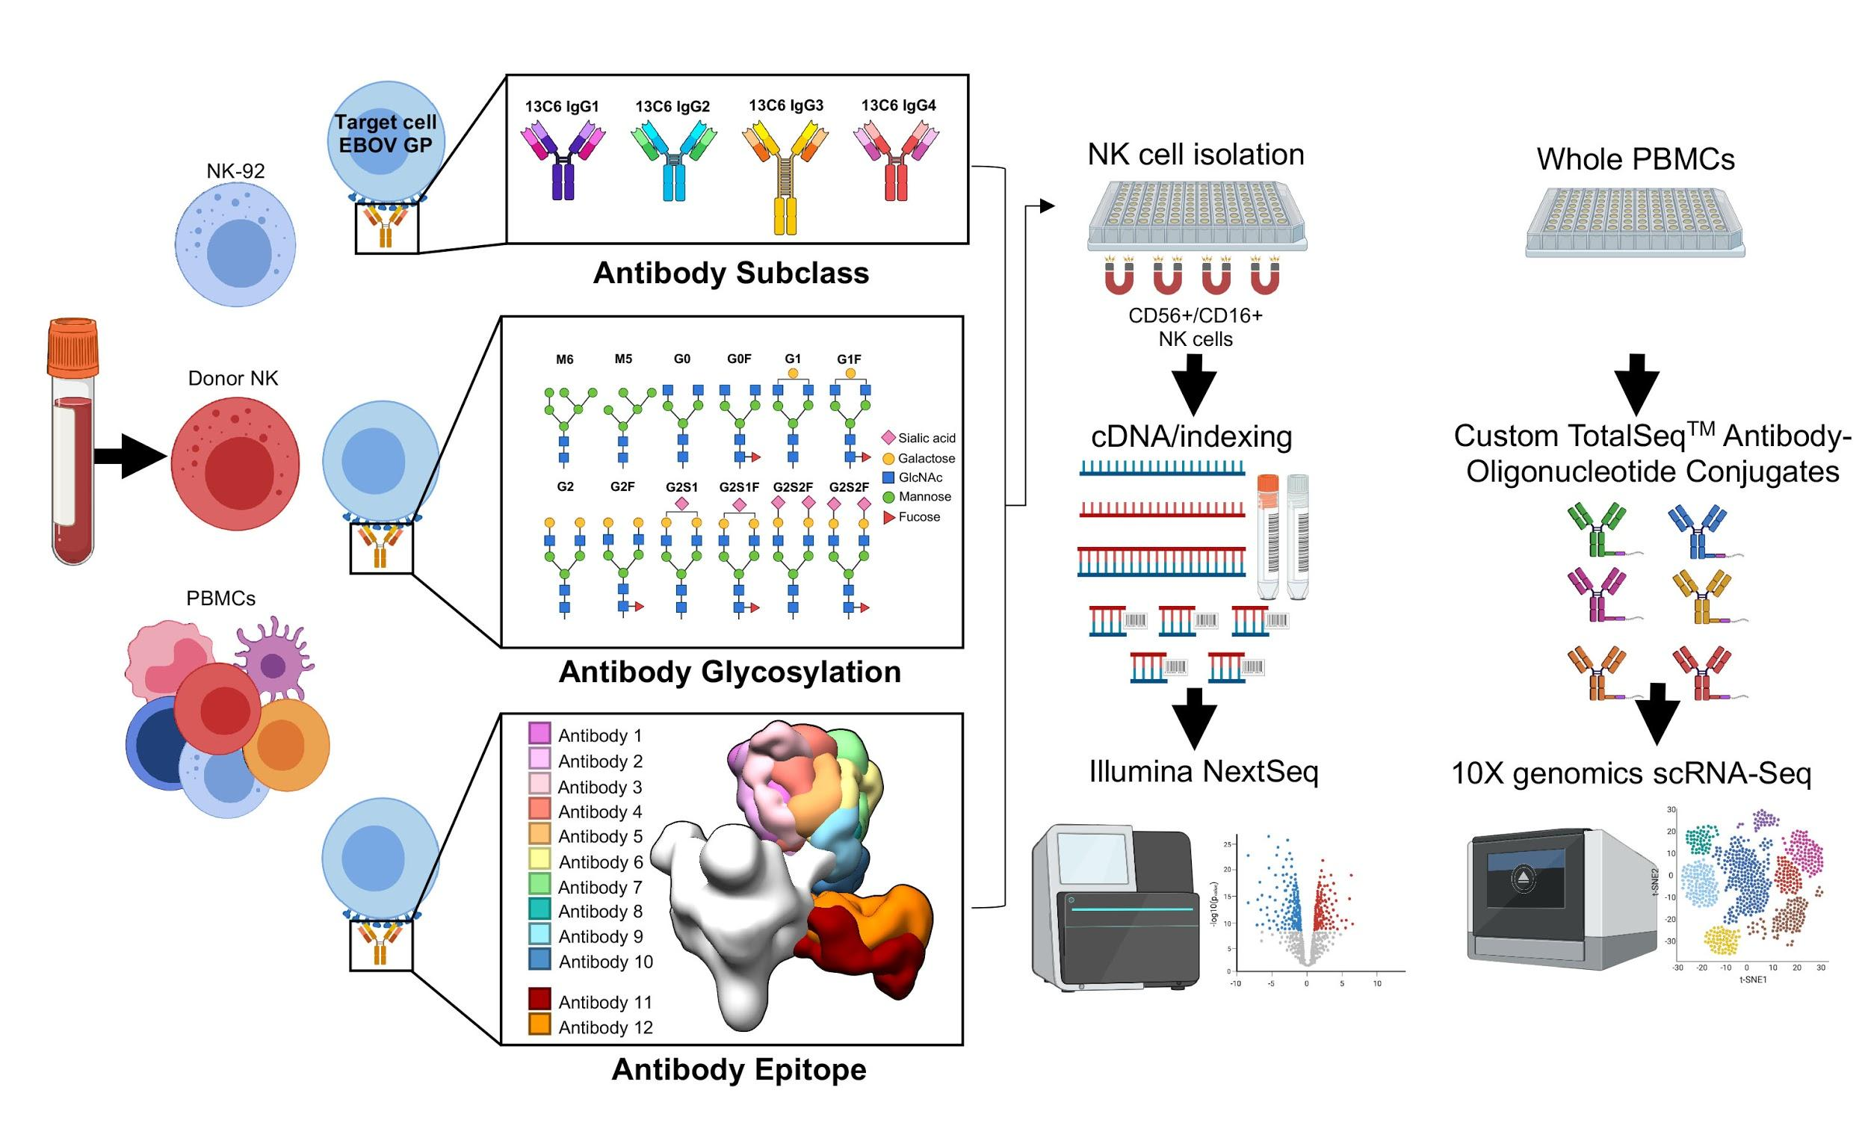
My relationship with bioinformatics at Scripps

Slide 5
Resources
A recent review on antibody geometry and NK cell ADCC I wrote: https://www.frontiersin.org/articles/10.3389/fimmu.2020.01635/full
TAS Course videos (you may need to request access to Dropbox): https://intranet.scripps.edu/education/graduate/courses/videos.html
NIH Awarded Grant search (who has money to fund what): https://projectreporter.nih.gov/reporter.cfm
Protein Data Bank (unified source for all things structural biology): https://www.rcsb.org/
BLAST (search for protein and nucleotide sequences): https://blast.ncbi.nlm.nih.gov/Blast.cgi

Slide 6
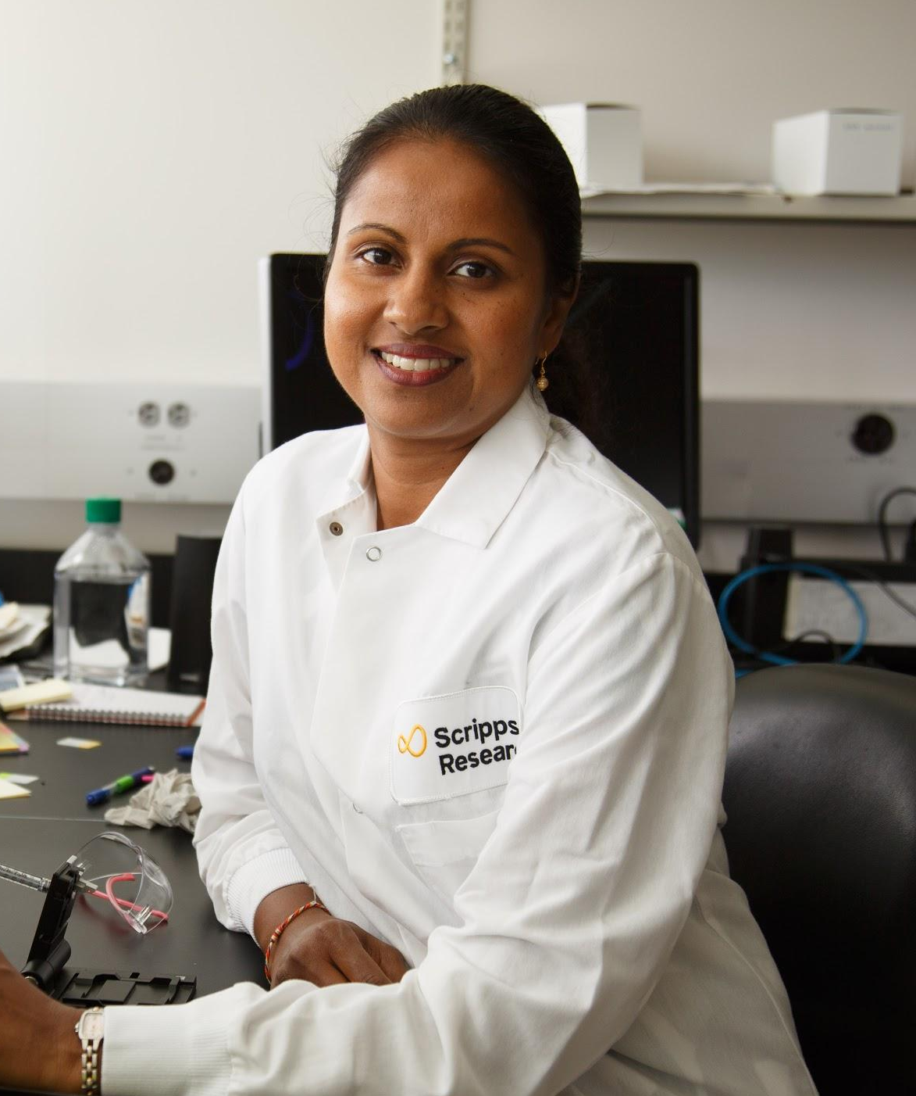
Pabalu Karunadharma, Ph.D. Scientific Director, Genomics Core
pkarunad@scripps.edu
Notes:
Want to know if you encounter unwelcoming behavior outside or inside classroom

Slide 7


Education
• B.A. Biology with emphasis in Biochemistry and Biotechnology -Minnesota State University Moorhead (MSUM)
• Ph.D. Biochemistry, Molecular Biology, and Biophysics (University of Minnesota)
• Post-doctoral studies: University of Washington
Investigating Aging and disease mechanisms through global proteomics and transcriptomics

Slide 8
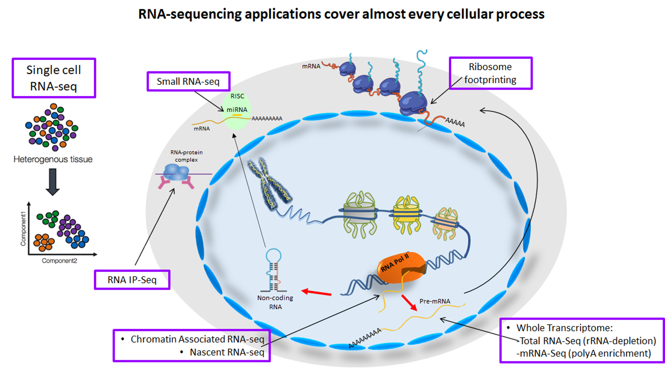

Slide 9
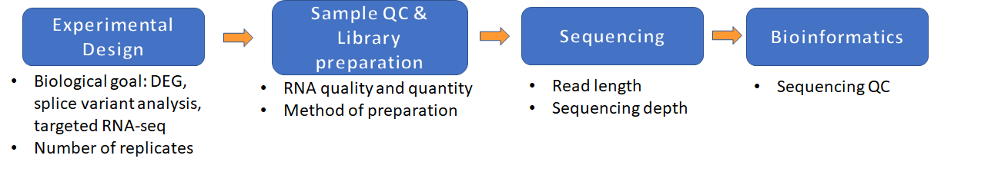
Resources
An overview of Next-Generation sequencing and instrumentation https://www.ibiology.org/techniques/next-generation-sequencing/
Introduction to RNA-seq and best practices from Iown institute of Human Genetics https://www.youtube.com/watch?v=7BLS_YY9HeM
Genomics Core RNA-seq workflow
- 20-25M reads RNAseq for DEG
- 10M reads small RNAseq
- 50M reads ribosome profiling
- 100M reads alternative splicing
- 2-3 Cell lines
- 3-4 Primary cells
- 4-5 Tissues
DEG = differential expression of genes

Slide 10
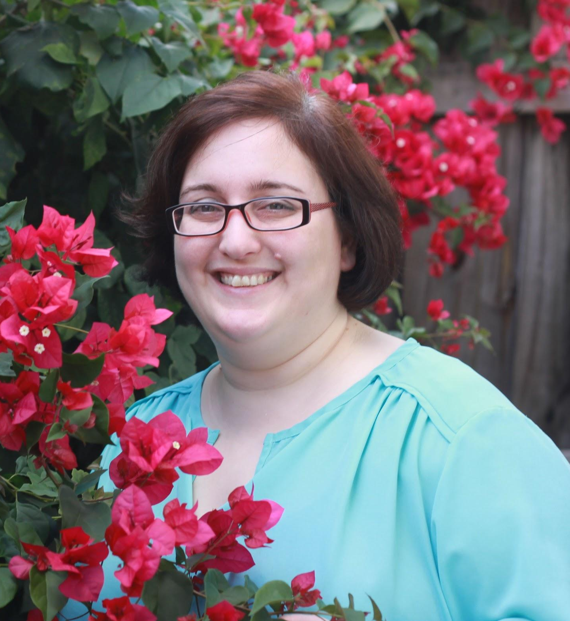
Gogce C. Crynen, Ph.D.
Bioinformatics Analyst IV
gcrynen@scripps.edu
Notes:
Want to know if you encounter unwelcoming behavior outside or inside classroom

Slide 11
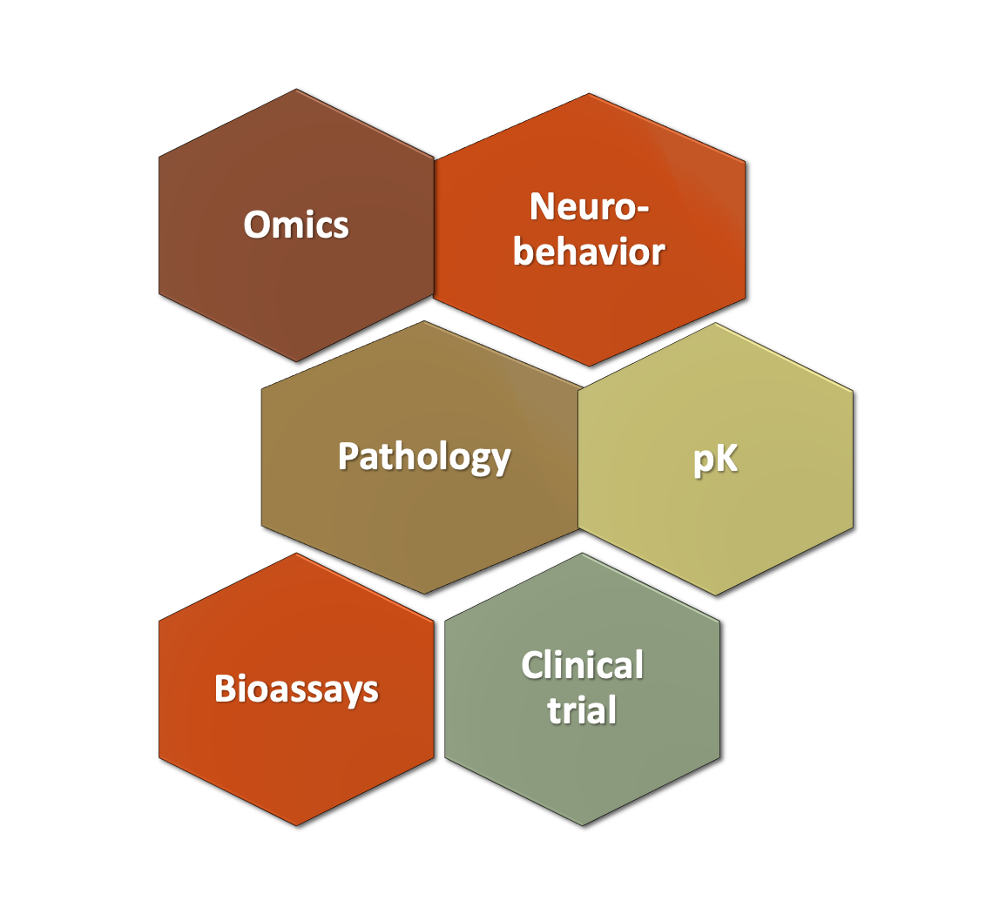


Slide 12


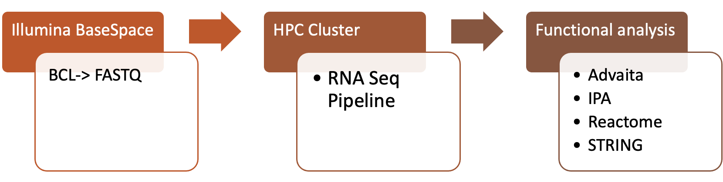

Slide 13

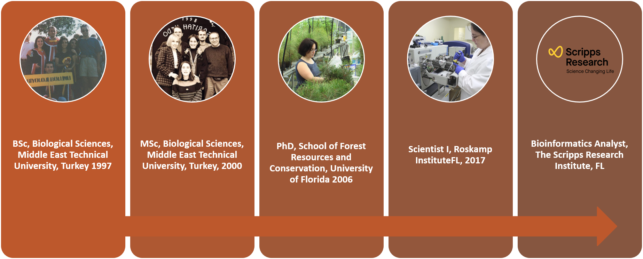

Slide 14
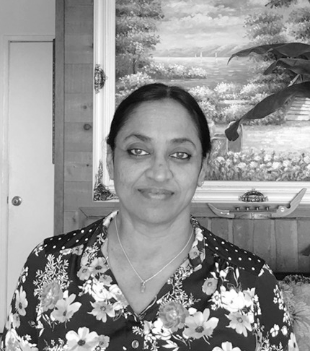
Padma Natarajan, Ph.D.
Bioinformatics Analyst IV
nataraja@scripps.edu
CCBB & Genomics Core
ccbb@scripps.edu
Notes:
Want to know if you encounter unwelcoming behavior outside or inside classroom

Slide 15




My Background:
Ph.D (Small Molecule Crystallography)
Postdoc (Protein/Virus Structure Determination using X-ray Crystallogr. and Cryo-EM; VIPERdb)
Staff Scientist (Protein Structures, Visualization, Functional Annotation of Domains of Unknown Function)
Staff Scientist & Bioinformatician
(NGS Data Analysis)

Slide 16



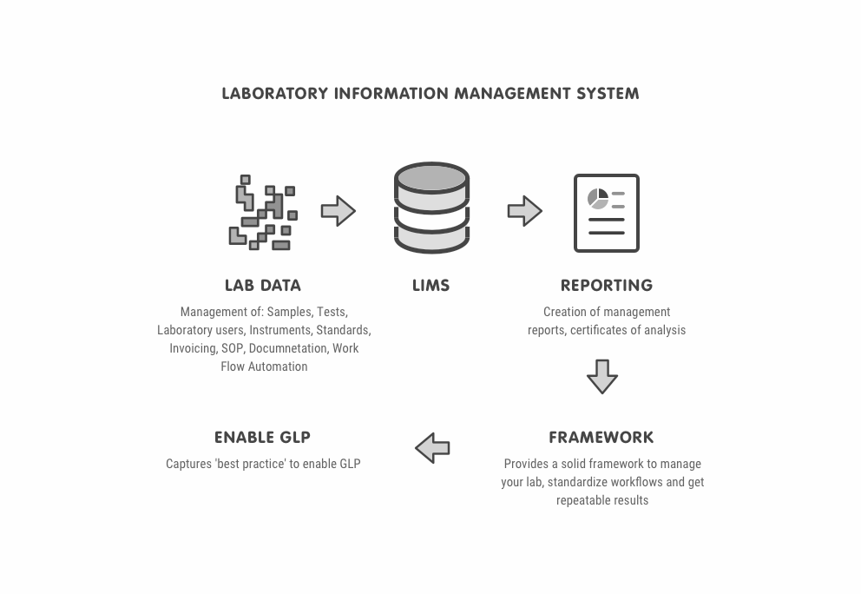

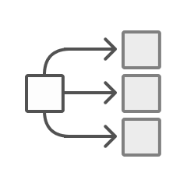
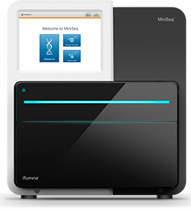
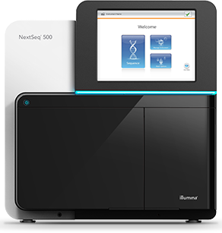





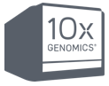
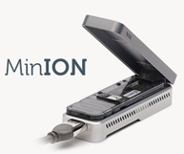
Overview
Bioinformatics Core:
CCBB
Sample Metadata
Runs
Projects
LIMS
Genomics Core
Internal
customers
MiSeq
NextSeq
Analysis Pipelines
Linux Cluster / FreeNAS
External
customers
Notes:
Overview of Genomics Core and CCBB (Center for Computational Biology and Bioinformatics)

Slide 17


Activities
Data storage
NextSeq
MiSeq
Novaseq
Nanopore
Analyses
RNASeq
Single Cell RNASeq
ChIPSeq
Metagenomics
smallRNASeq
Variant calling
Functional Analysis
-------------
GEO submissions
Custom
Specific to lab
Internal projects
Work for a grant
Resources
https://statquest.org/video-index/
https://nf-co.re/pipelines
Notes:
https://statquest.org/video-index/
This page contains links to playlists and individual videos on Statistics, Statistical Tests, Machine Learning, Webinars and Live Streams

Slide 18
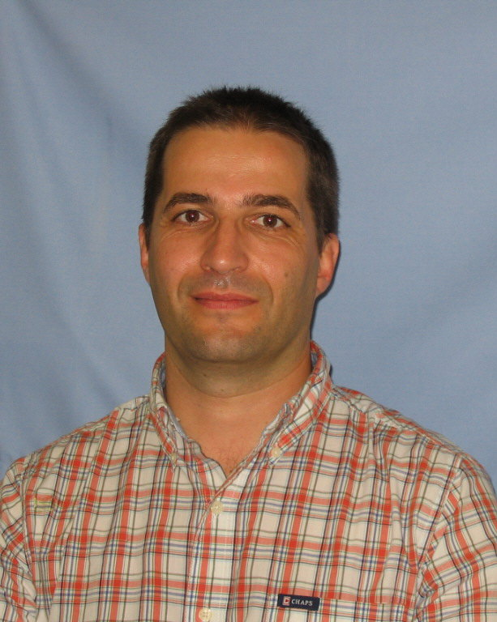
Jean-Christophe Ducom, Ph.D.
HPC Director
jcducom@scripps.edu
Notes:
Want to know if you encounter unwelcoming behavior outside or inside classroom

Slide 19
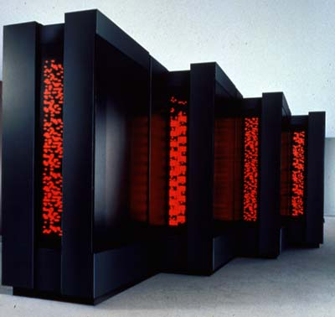
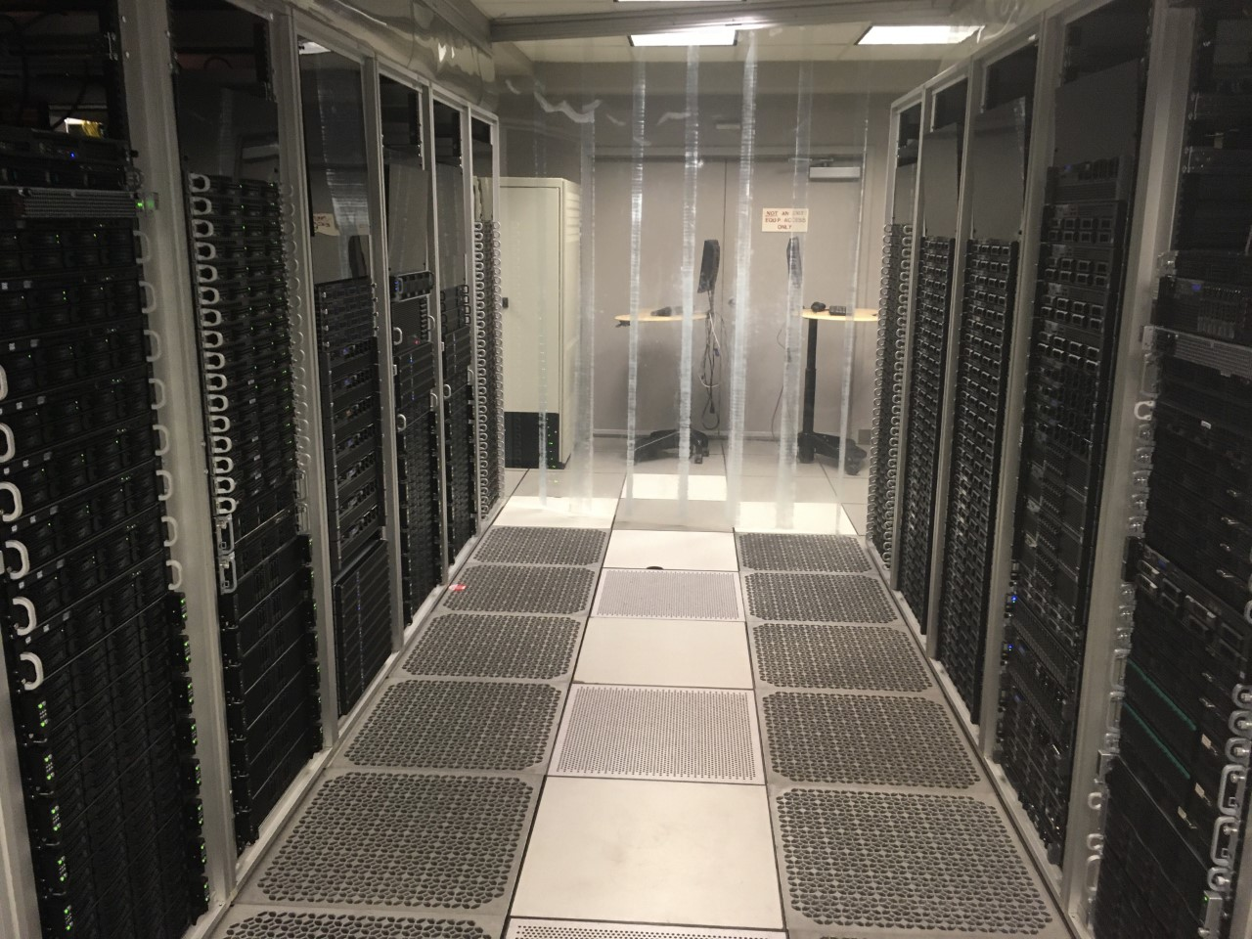
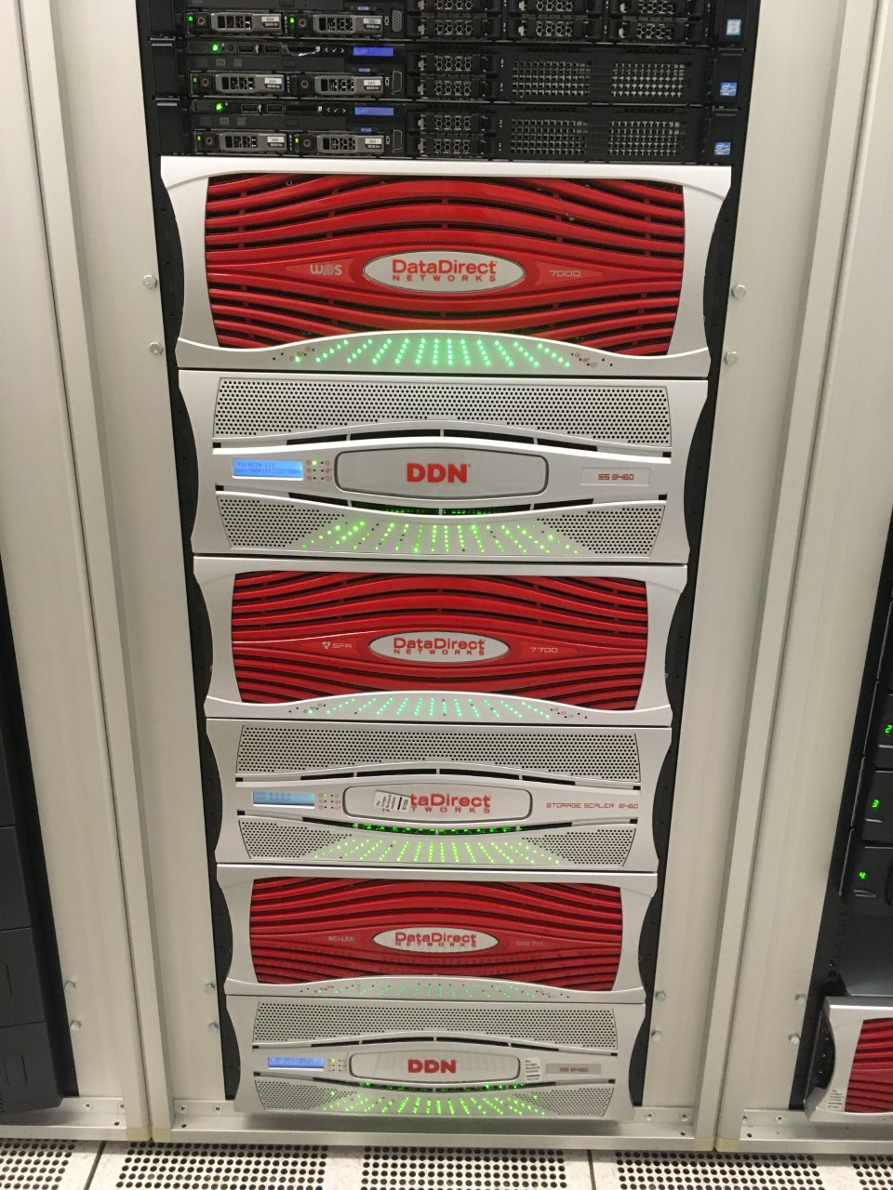
Education
Ph.D. in Theoretical Physics
Postdocs Georgetown University /University of Rochester
Co-founder of MegaLinux company
SCF at University of Notre Dame, IN
(BoB cluster #457, 200GFlops, 2002)
HPC at Scripps Research Institute
photographer: Tom Trower, 1993

Slide 20
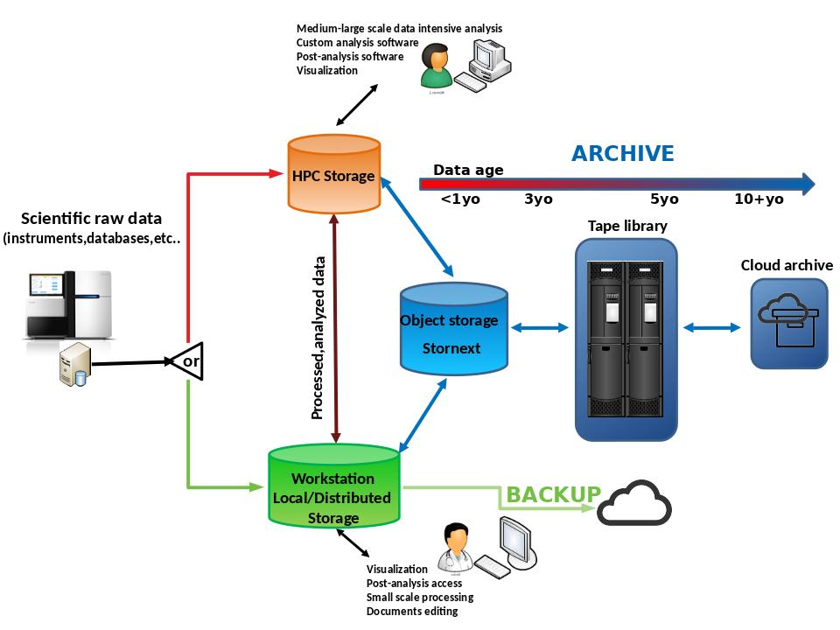
Activities
Day-to-day HPC operations (security, optimizations,equipment maintenance)
Computational Scientific support
Develop HPC vision for Scripps Research Institute
Data management

Slide 21
Resources
https://training.linuxfoundation.org/training/
https://www.xsede.org/for-users/training
AWS, GCP, Azure online documentation
https://www.computer.org/publications/tech-news/trends/programming-languages-you-should-learn-in-2020
https://home.cern/news/announcement/computing/online-introductory-lectures-quantum-computing-6-november

Slide 22
60 min Open Q&A

